Slide 1

EE307 Project Presentation
Topic:Broadband Planar SIW Cavity-Backed Slot Antennas Aided by Unbalanced Shorting Vias
Ji Chenqing Ji Xianglin Zhang Juntao

Slide 2
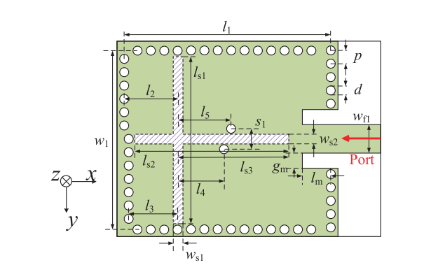
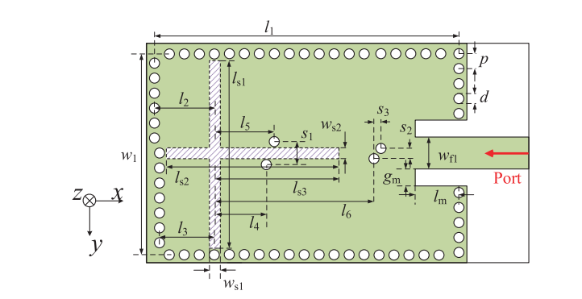
Introduction
Substrate integrated waveguide (SIW)-like cavity backed slot (CBS) antennas have been widely investigated for various applications including satellite communications and wireless communications recently because of their outstanding advantages of easy integration with planar circuits, low profile, and excellent directional radiation performance.
In this paper, two types of substrate integrated waveguide (SIW) cavity-backed slot (CBS) antennas are proposed for bandwidth enhancement.

Slide 3
QUAD-MODE SIW CBS ANTENNA
Quad-resonance SIW CBS antenna is proposed using a cross-shaped slot and loading unbalanced shorting vias. Additional half-TE120 mode is successfully excited along with three other independent modes including half-TE110 and odd and even TE210 modes.
Model in paper

Slide 4
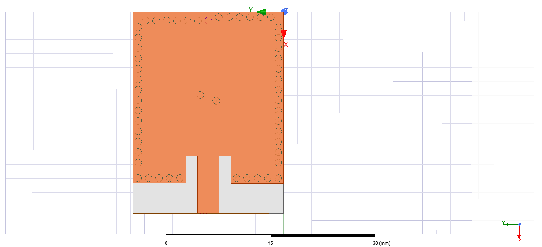
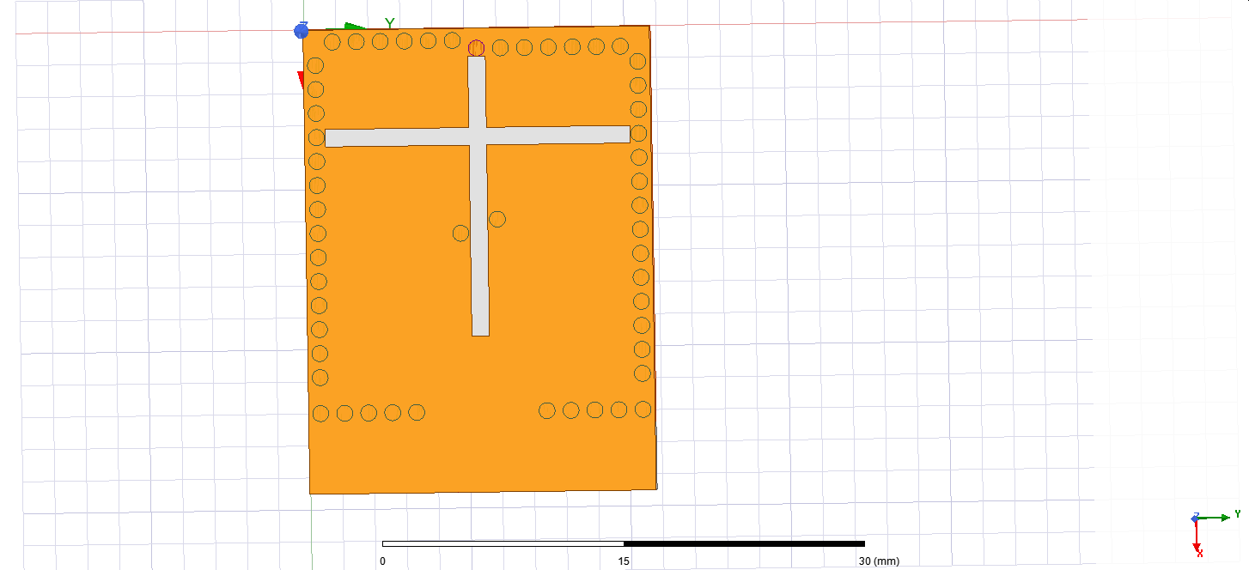
QUAD-MODE SIW CBS ANTENNA
Our model in HFSS

Slide 5
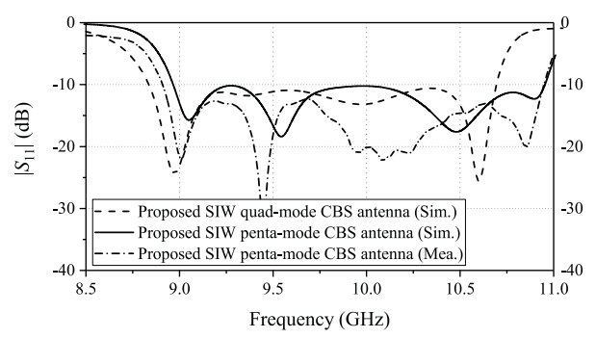
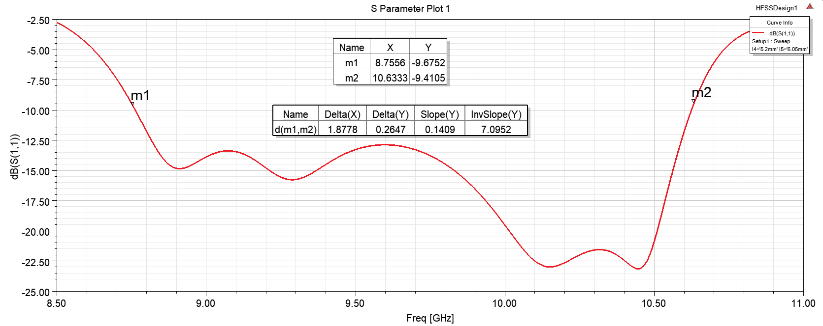
QUAD-MODE SIW CBS ANTENNA
Simulation result : S11 in dB
S11 shown in paper
Result in our work
measured fractional bandwidth:
20.8% (8.9–10.9 GHz)
measured fractional bandwidth:
18.8% (8.75–10.73 GHz)

Slide 6
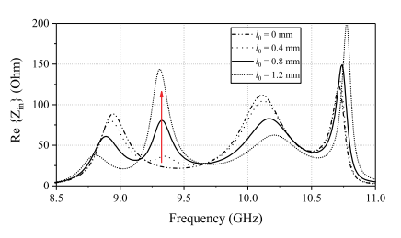
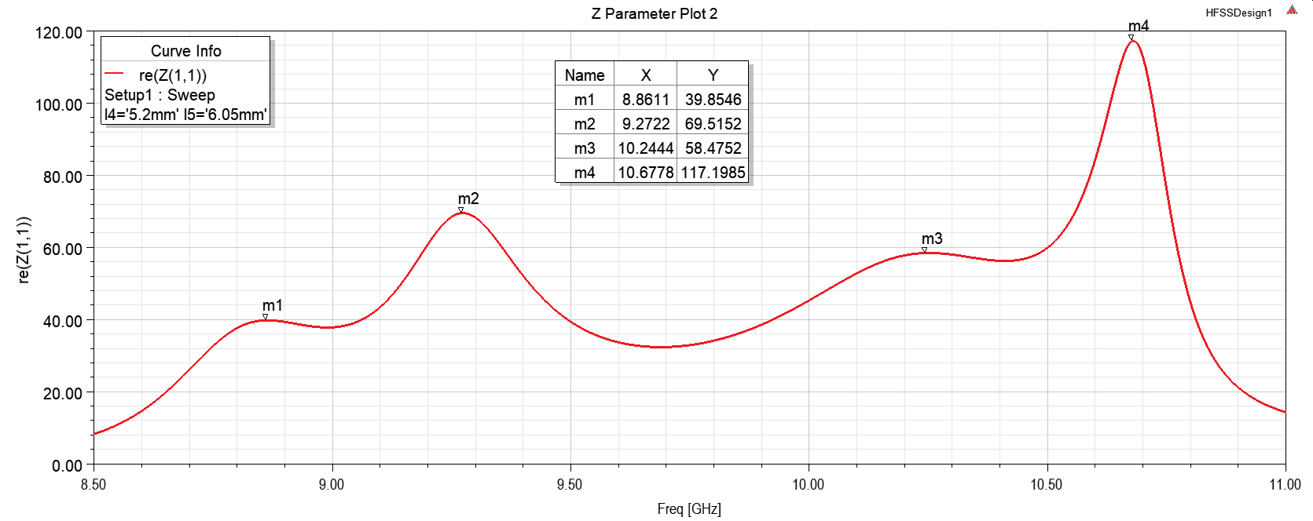
QUAD-MODE SIW CBS ANTENNA
Simulation result: Input
Result shown in paper
Result in our work

Slide 7
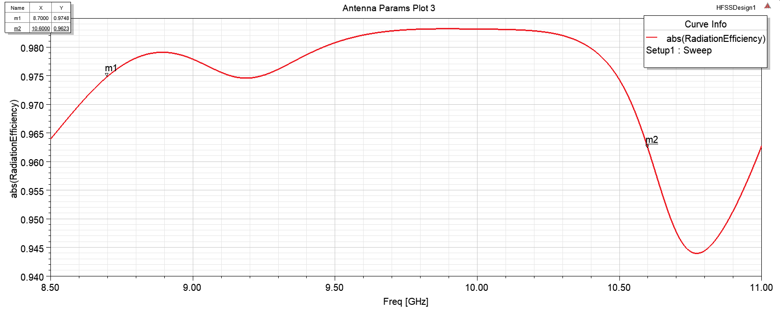
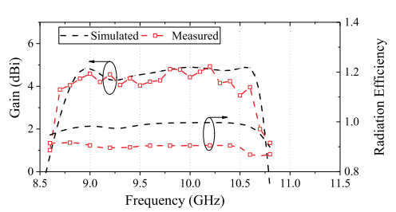
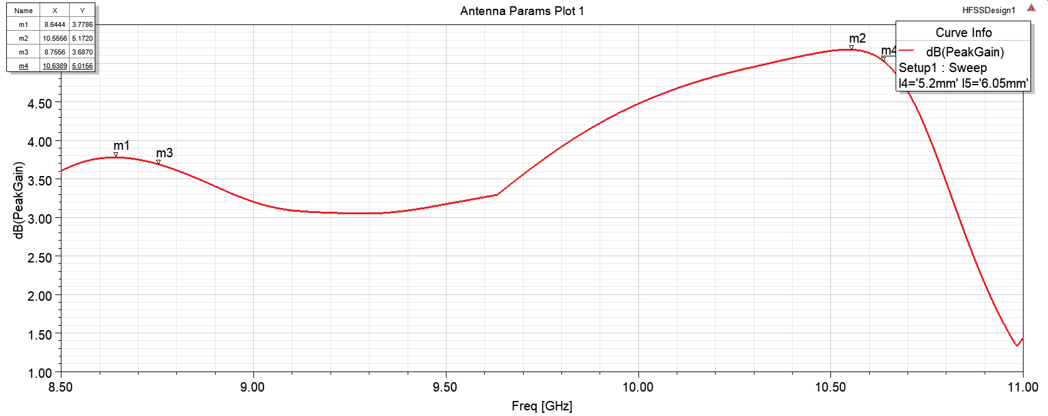
QUAD-MODE SIW CBS ANTENNA
Simulation result : Radiation Efficiency && Gain
Result shown in paper
Result in our work
Top：Radiation Efficiency
Max Radiation Efficiency 0.986 around 10GHz
Bottom：Gain
Max PeakGain 5.17 dB at 10.55GHz

Slide 8
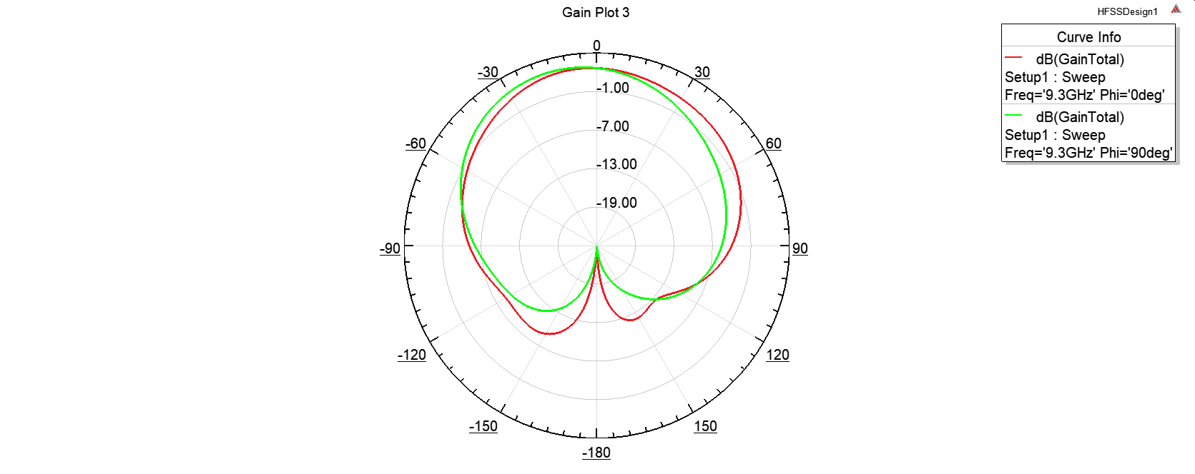
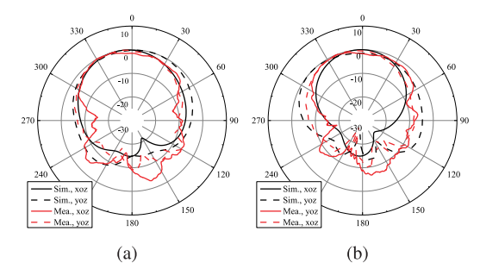
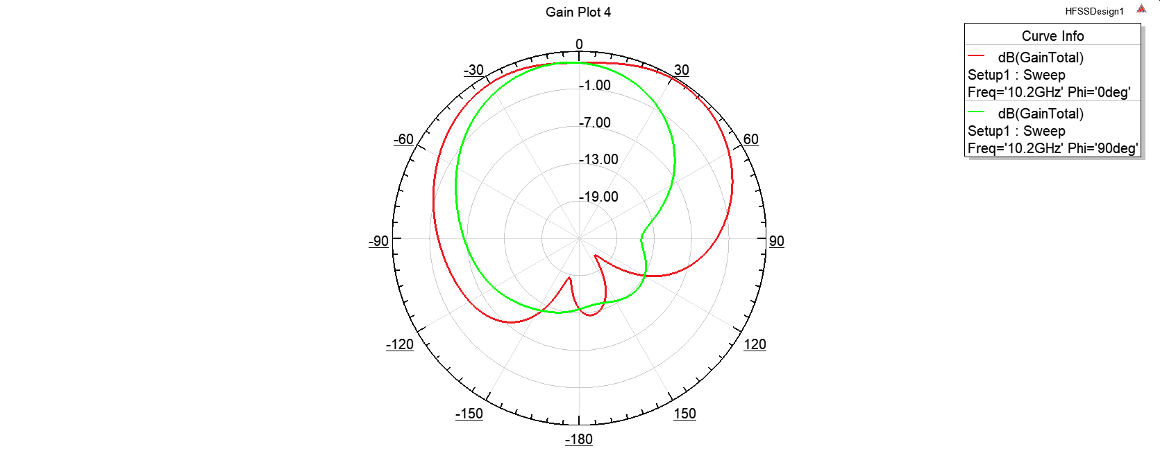
QUAD-MODE SIW CBS ANTENNA
Simulation result : Radiation Pattern (Gain Total)
Result shown in paper
Left 9.6GHz
Right:10.4GHz
Result in our work
Top：9.6GHz
Bottom：10.4GHz

Slide 9
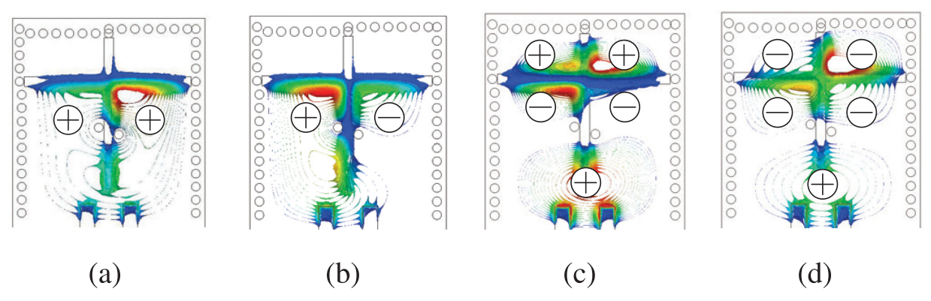
QUAD-MODE SIW CBS ANTENNA
Simulation result : Electric field Distributions
Result shown in paper
From left to right :8.9, 9.3, 10.2 and 10.7 GHz.

Slide 10
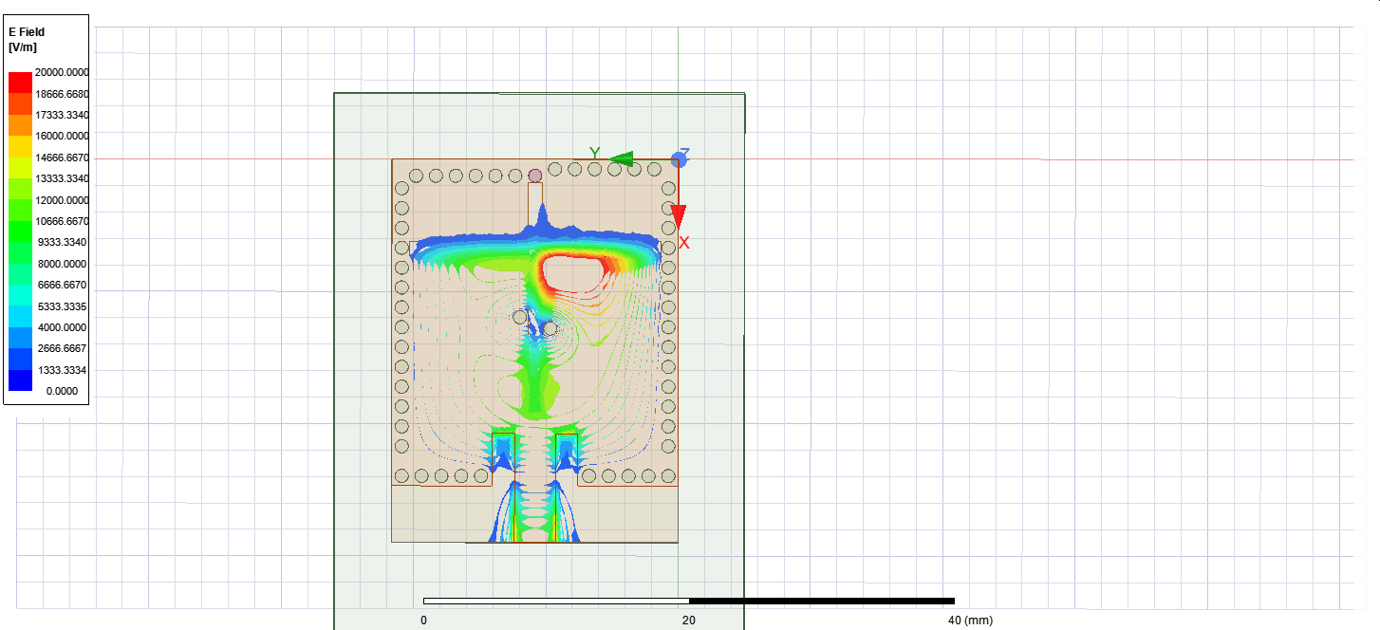
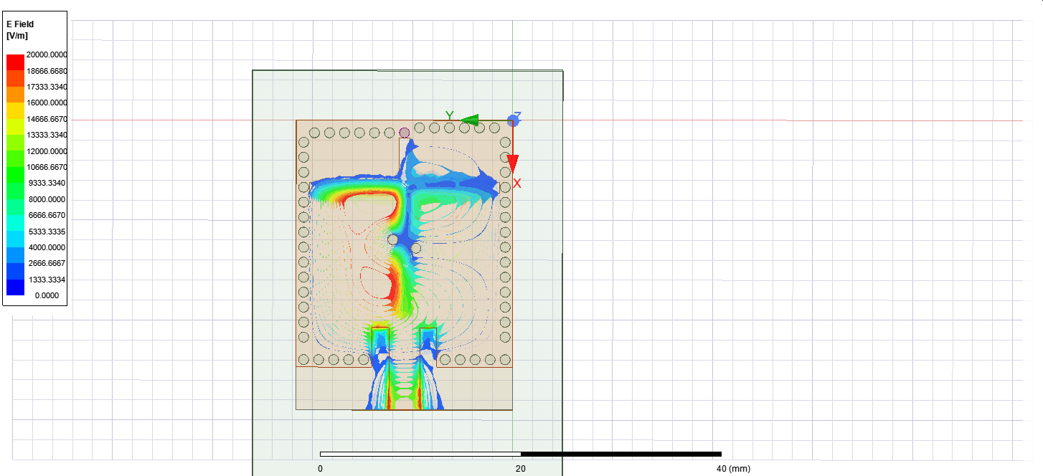
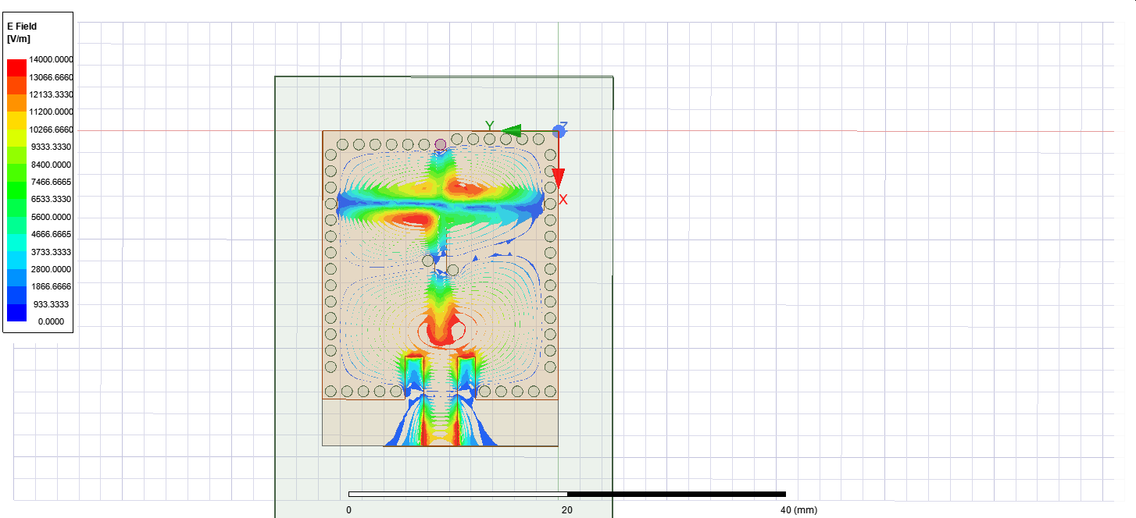
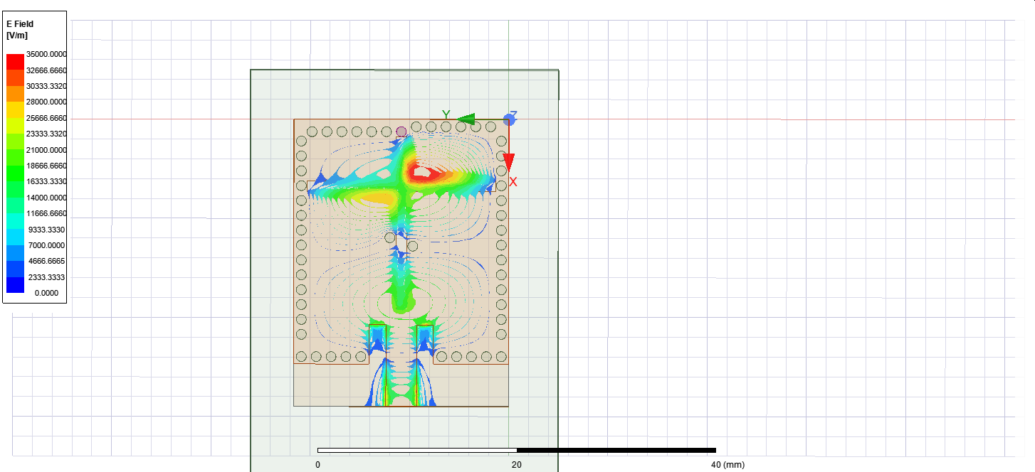
QUAD-MODE SIW CBS ANTENNA
Simulation result : Electric field Distributions
half-TE110 mode
half-TE120 mode
odd TE210 mode
even TE210 mode
Result in our work
From left to right: 8.9, 9.3, 10.2 and 10.7 GHz.

Slide 11
PENTA-MODE SIW CBS ANTENNA
Penta-resonance SIW CBS antenna with a cross-shaped slot is proposed, in which two pairs of shorting vias are loaded. Two additional hybrid modes of half-TE210 and half-TE120 modes are introduced along with three other independent modes including half-TE110 and odd and even TE310 modes.
Model in paper

Slide 12
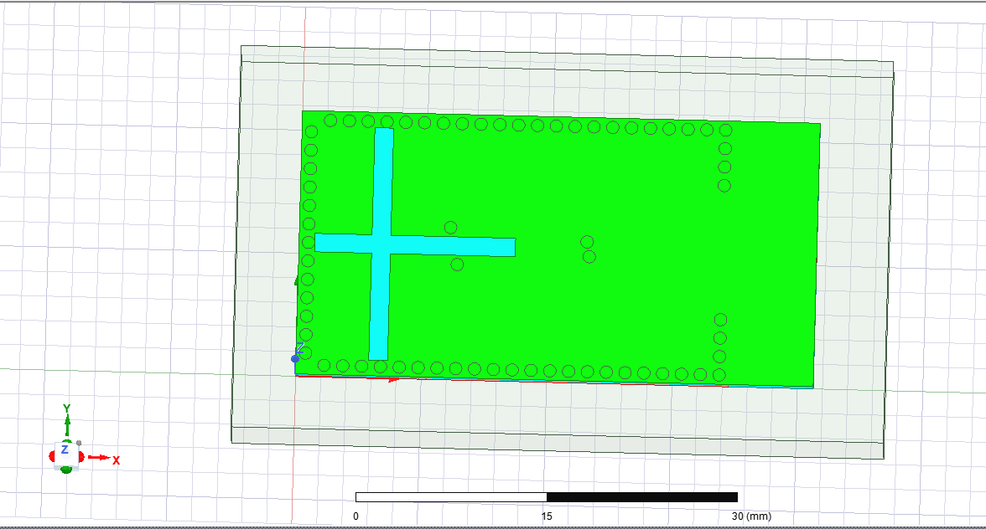
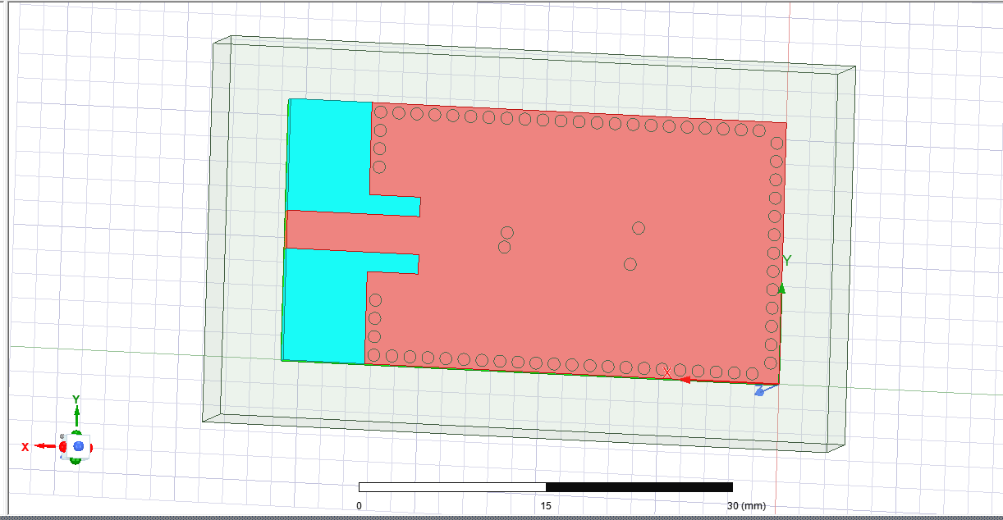
PENTA-MODE SIW CBS ANTENNA
Our model in HFSS

Slide 13
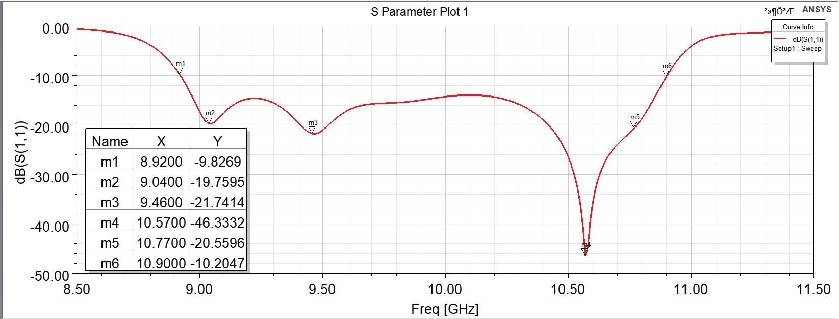
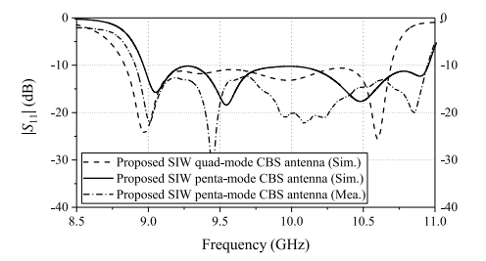
PENTA-MODE SIW CBS ANTENNA
Simulation result : S11 in dB
S11 shown in paper
Result in our work
measured fractional bandwidth:
20.8% (8.89–10.95 GHz)
measured fractional bandwidth:
20.7% (8.92–10.90 GHz)

Slide 14
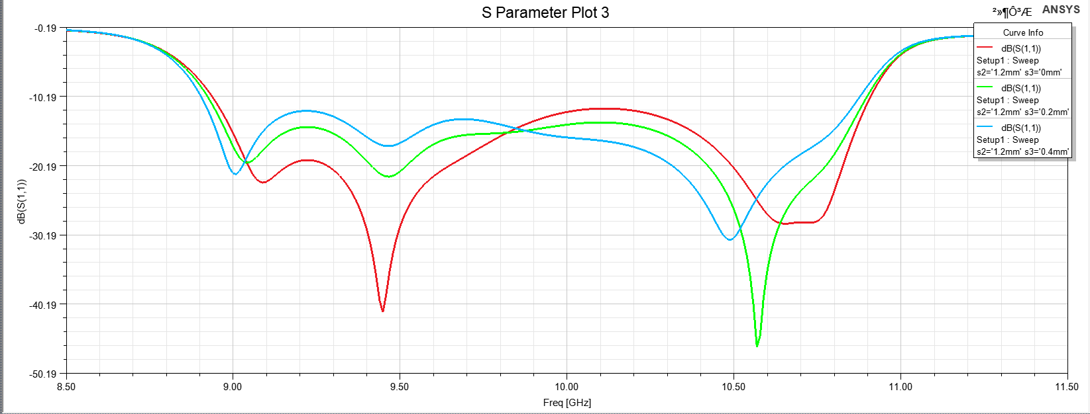
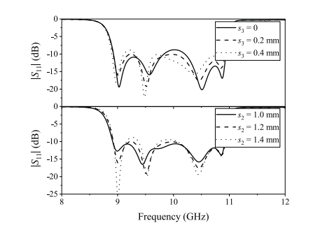
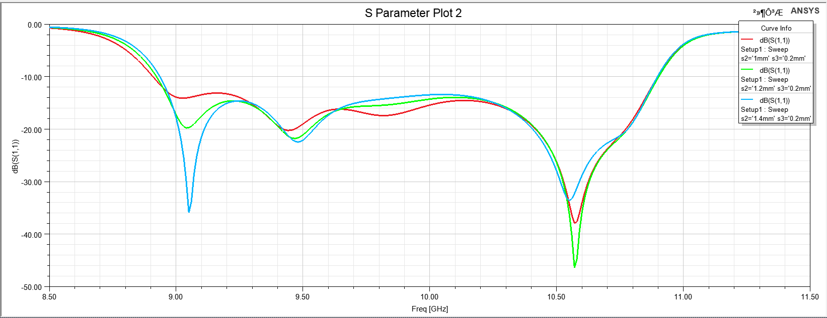
PENTA-MODE SIW CBS ANTENNA
Simulation result : Reflection coefficient with varying values of s2 and s3
Result shown in paper
Result in our work

Slide 15
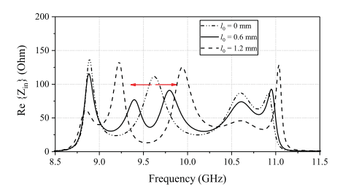
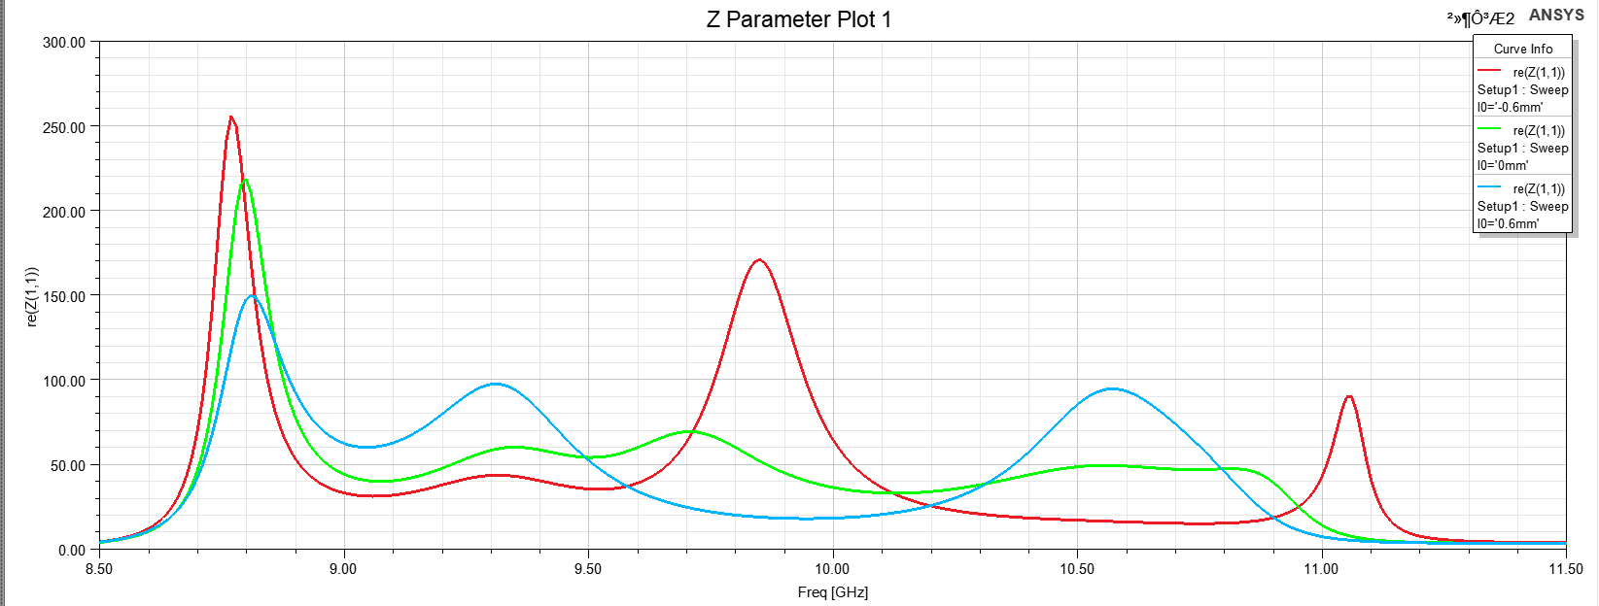
PENTA-MODE SIW CBS ANTENNA
Simulation result: Input resistance with varying value of the offset l₀ between the two vias. (Note: l₀=l₅-l₄)
Result shown in paper
Result in our work
Conclusion: We can see that when l₀ changes from -0.6mm to 0mm, between 9.50GHz and 10GHz, the original half TE210 mode will be replaced by two separate hybrid resonant modes. Therefore, we finally use l₀ = 0 mm (corresponding to l₀ = 0.6mm in the paper) to balance the trade-off between reflection performance and bandwidth.

Slide 16
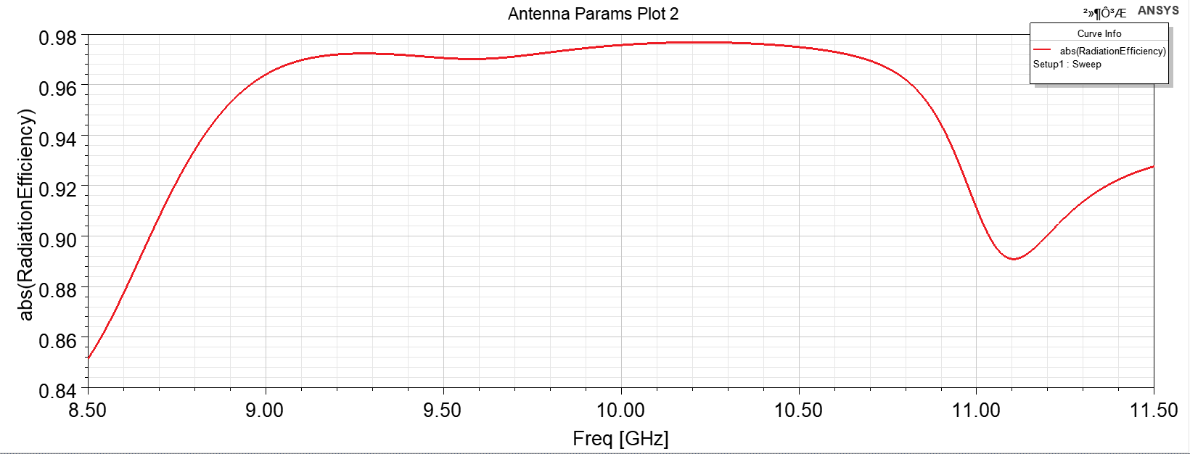
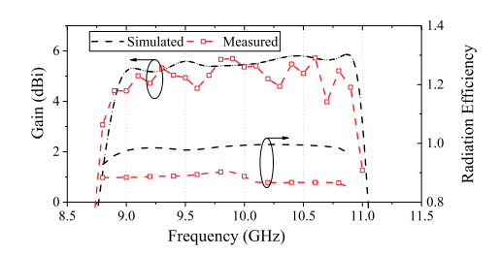
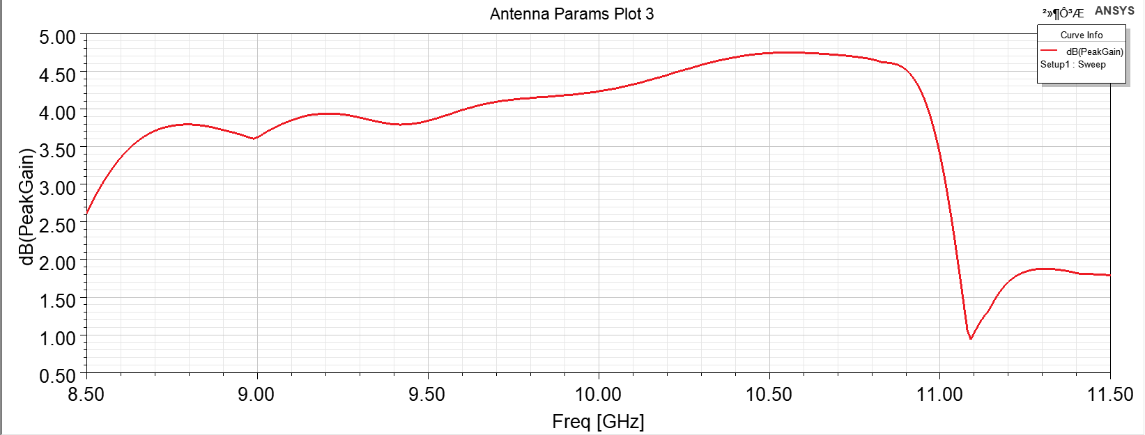
PENTA-MODE SIW CBS ANTENNA
Simulation result : Radiation Efficiency && Gain
Result shown in paper
Result in our work
Top：Radiation Efficiency
Max Radiation Efficiency 0.9768 at 10.21GHz
Bottom：Gain
Max PeakGain 4.745 dB at 10.58GHz

Slide 17
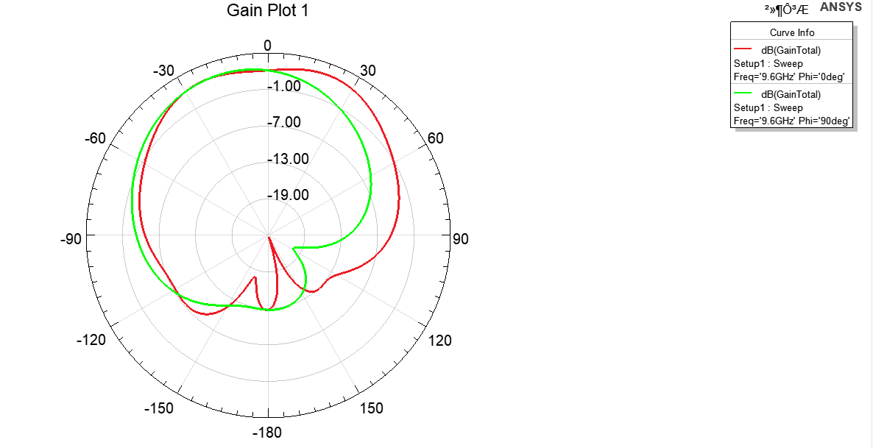
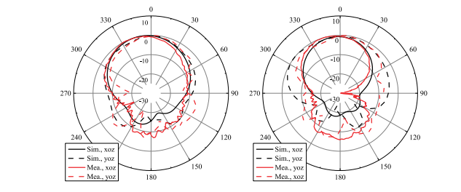
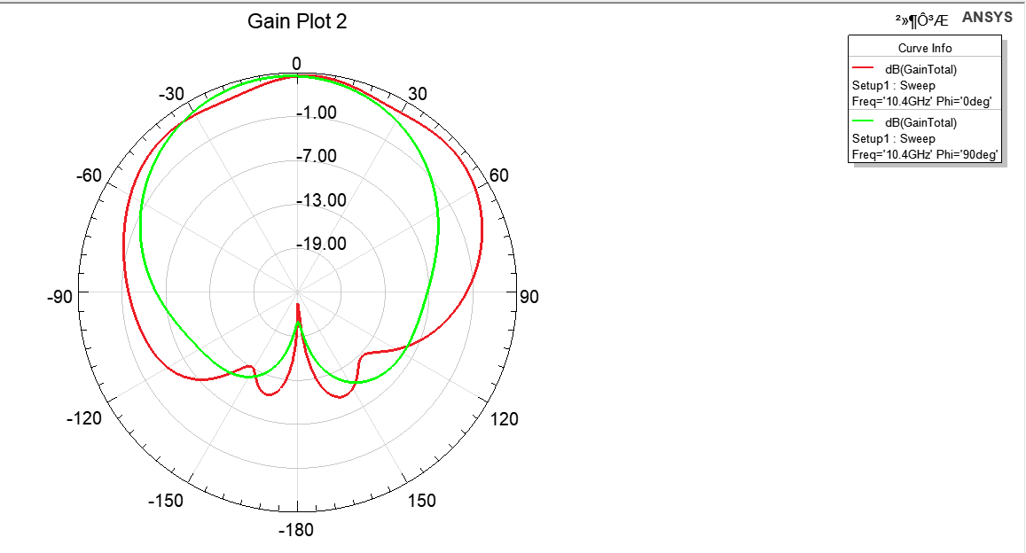
PENTA-MODE SIW CBS ANTENNA
Simulation result : Radiation Pattern (Gain Total)
Result shown in paper
Left 9.6GHz
Right:10.4GHz
Result in our work
Top：9.6GHz
Bottom：10.4GHz

Slide 18
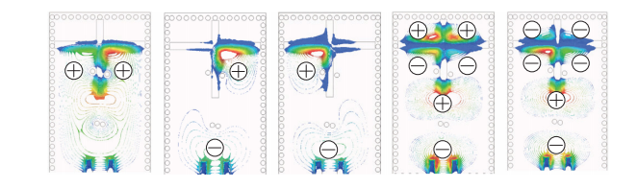
PENTA-MODE SIW CBS ANTENNA
Simulation result : Electric field Distributions
Result shown in paper
From left to right :8.9, 9.4, 9.8, 10.6 and 10.9 GHz.

Slide 19
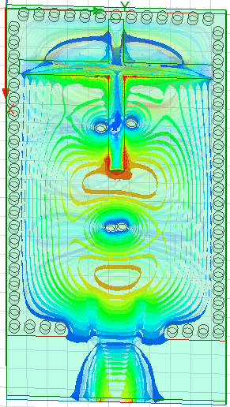
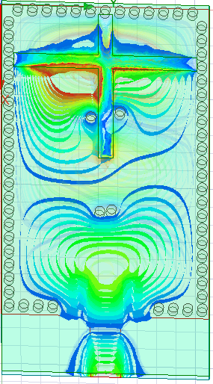
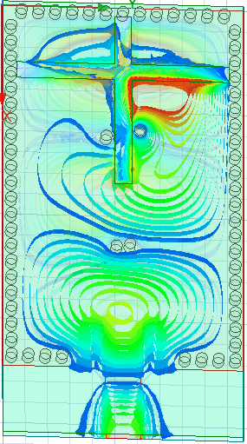
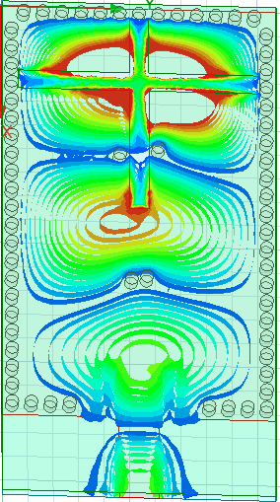
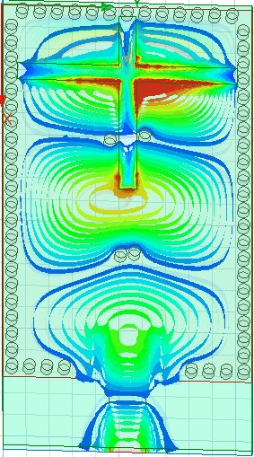
PENTA-MODE SIW CBS ANTENNA
Simulation result : Electric field Distributions
Two hybrid mode
(half-TE210 、half-TE120 mode)
Half-TE110 mode
Odd TE310 mode
Even TE310 mode
Result in our work
From left to right: 8.9, 9.4, 9.8, 10.6 and 10.9 GHz.

Slide 20
Exploration： Why Should PENTA-MODE SIW CBS ANTENNA Seen Like This？
-- The importance of asymmetric shorting vias and cross-shaped slots in this antennas structure was significant during our modeling. Therefore, we try to further explore the antenna structure to observe the influence of these two parts on the performance of the antenna.

Slide 21
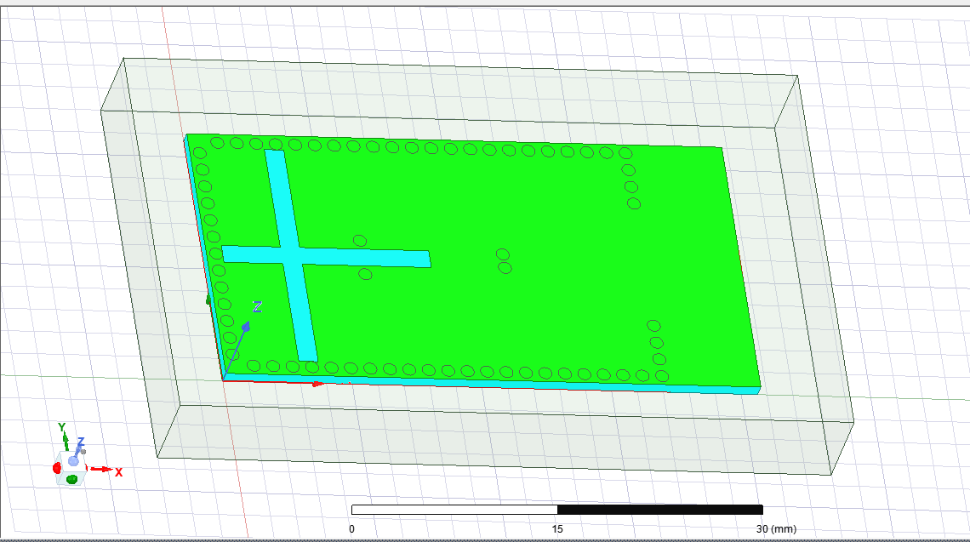
1.The four shorting vias in the middle are symmetrical
Our Model in HFSS

Slide 22
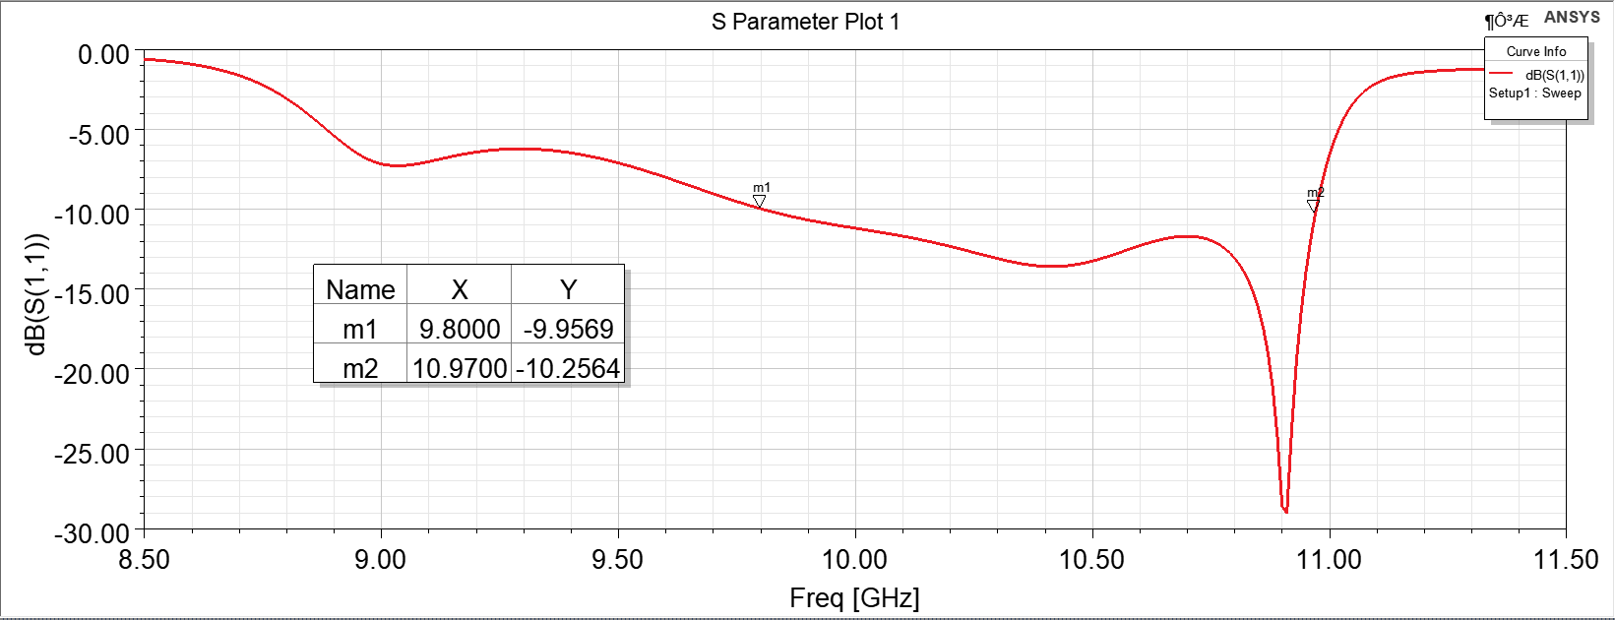
1.The four shorting vias in the middle are symmetrical
S11 shown in our work
It can be seen from the S11 parameter figure that if we make all the four shorting vias in the middle symmetrical, the antenna bandwidth produced is not as good as the asymmetric Penta-mode. Therefore, the maximum effect of asymmetric shorting vias is to increase the resonant mode to improve the bandwidth.

Slide 23
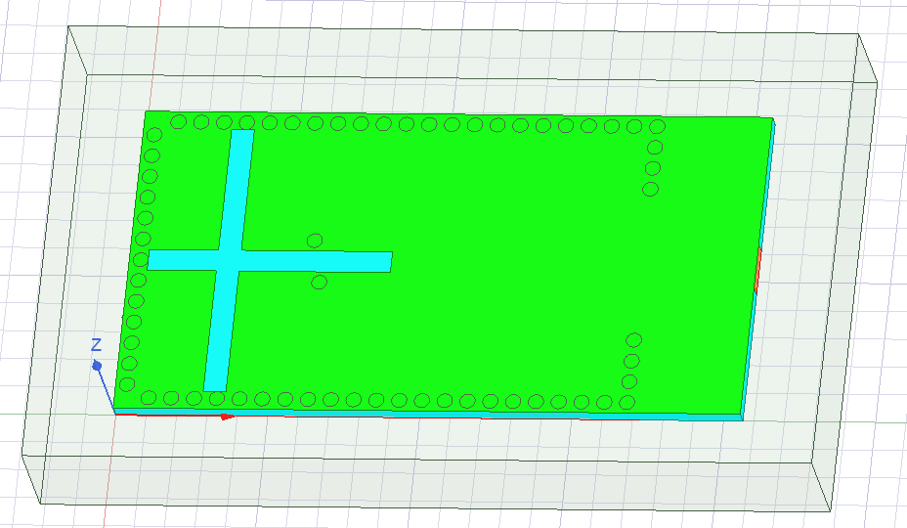
2. Two shorting vias in the front are not exist
Our Model in HFSS

Slide 24
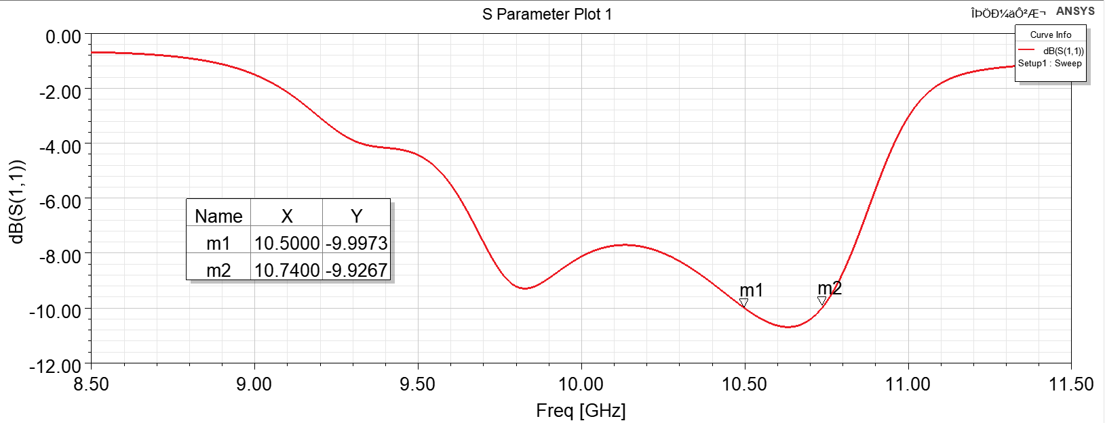
2. Two shorting vias in the front are not exist
According to the S11 parameter in the above figure, if we do not place two asymmetric shorting vias at the front end of the middle part, the bandwidth of the antenna produced is only 0.2GHz, so the maximum effect of two asymmetric shorting vias at the front end of the middle part is to improve the bandwidth of the antenna.
S11 shown in our work

Slide 25
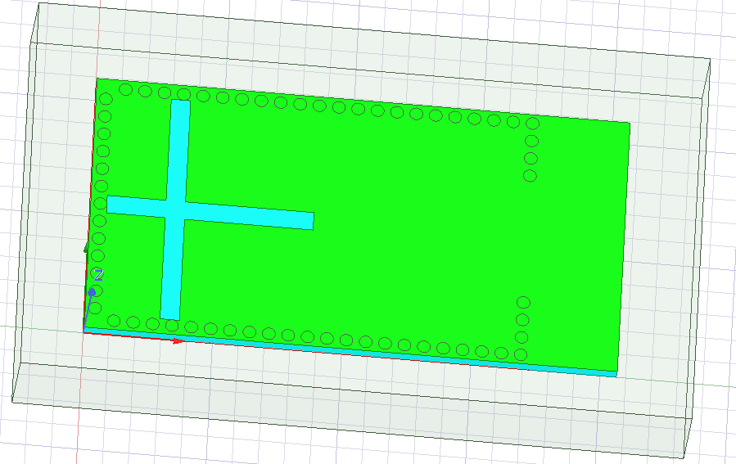
3. All four shorting vias in the middle are not exist
Our Model in HFSS

Slide 26
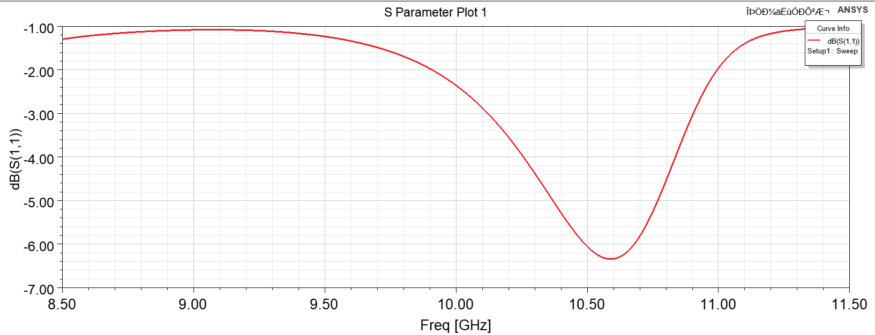
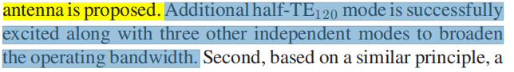
3. All four shorting vias in the middle are not exist
According to the S11 parameter above, we can see that if we do not put any shorting vias on both sides of the cross slot, the S11 parameters will become very large and cannot meet our design requirements. Therefore, the functions of four unbalanced shorting vias on both sides of the cross slot are:
1. Reduce the reflection coefficient of the antenna
2. Add new resonant mode to improve the bandwidth of antenna
S11 shown in our work

Slide 27
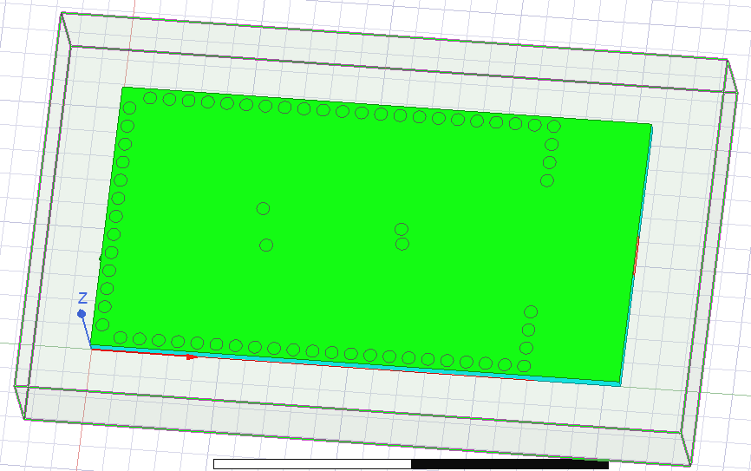
4. The cross-shaped slots is not exist
Our Model in HFSS

Slide 28
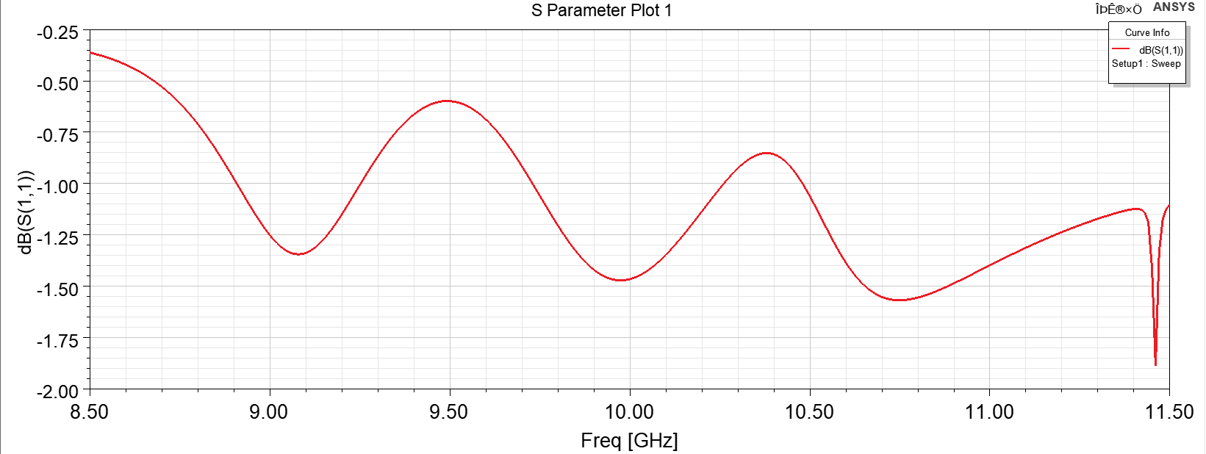
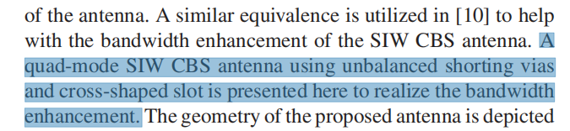
4. The cross-shaped slots is not exist
S11 shown in our work
We can see that if we do not add the cross slots, the S11 parameters are too large to meet our design requirements. So the effect of digging a cross slot in the design is similar to the effect of placing unbalanced shorting vias on both sides in order to reduce the value of the reflection coefficient and increase the bandwidth. There is a synergistic effect between the both. Right?

Slide 29

5. All shorting vias around the model are not exist
Our Model in HFSS

Slide 30


5. All shorting vias around the model are not exist
According to the S11 parameter above, if we do not place shorting vias around the antenna model, the bandwidth of the antenna produced is only 0.25GHz. Therefore, equidistantly placing shorting vias around the patch can improve the bandwidth of the antenna by forming the SIW cavity.
S11 shown in our work

Slide 31

6. All shorting vias have been hollowed out
Our Model in HFSS

Slide 32

6. All shorting vias have been hollowed out
S11 shown in our work
According to the S11 parameter above, we can see that if we drill holes, the bandwidth of this antenna is only 0.6GHz. This result is not as good as the bandwidth of penta mode without perforation.

Slide 33


6. All shorting vias have been hollowed out
Although the bandwidth of the antenna designed in this way is relatively small, the maximum gain and radiation efficiency of this structure are better than that of penta mode without being hollowed out.
PeakGain and RadiationEfficiency shown in our work

Slide 34

7. Blank Control Group
Our Model in HFSS

Slide 35

7. Blank Control Group
S11 shown in our work
As can be seen from the S11 parameter above, if the front side of the antenna only has patches, the S11 parameters of the antenna produced are too large to meet our design requirements.

Slide 36


7. Blank Control Group
Radiation Pattern (Gain Total) in our work
Left 9.6GHz Right:10.4GHz
At the same time, the radiation pattern of the GainTotal shows that the gain of this antenna is isotropic. Therefore, we can better understand the importance of placement of shorting vias and cross slots through this exploration.

Slide 37


PENTA-MODE SIW CBS ANTENNA
With unbalanced shorting vias on boundary
Inconsistency in paper

Slide 38


PENTA-MODE SIW CBS ANTENNA
With unbalanced shorting vias on boundary
Our model in HFSS

Slide 39

PENTA-MODE SIW CBS ANTENNA
Simulation result
S11 shown in paper
our work
measured fractional bandwidth:
20.8% (8.89–10.95 GHz)
measured fractional bandwidth:
18.7% (8.92–10.76 GHz)

Slide 40


PENTA-MODE SIW CBS ANTENNA
Simulation result
Radiation pattern shown in paper
our work

Slide 41



PENTA-MODE SIW CBS ANTENNA
Simulation result
Gain and efficiency shown in paper
Our work
Gain: peak gain5.7dBi
Efficiency:larger than 84%
Gain: peek gain 4.55 dBi
Efficiency: larger than 88%

Slide 42

PENTA-MODE SIW CBS ANTENNA
Simulation result
independent variable: l0
dependent variable: Z11

Slide 43

PENTA-MODE SIW CBS ANTENNA
Simulation result
independent variable: S3
dependent variable: S11

Slide 44

PENTA-MODE SIW CBS ANTENNA
Simulation result
independent variable: S2
dependent variable: S11

Slide 45



Another work of QUAD-MODE SIW CBS ANTENNA
In this design, a wide bandwidth is also obtained by combining the lowest cavity mode to two higher modes using shorting vias.

Slide 46


Another work of QUAD-MODE SIW CBS ANTENNA
Our model in HFSS

Slide 47


Another work of QUAD-MODE SIW CBS ANTENNA
Simulation result
S11 shown in paper
our work
measured fractional bandwidth:
17.5% (9.36–11.26 GHz)
measured fractional bandwidth:
15.3% (9.33–10.88 GHz)

Slide 48


Another work of QUAD-MODE SIW CBS ANTENNA
Simulation result
Gain and efficiency shown in paper
Our work
Gain: a peak gain7.27 dBi and a gain variation of within 1.5 dB from 9.4 to 11 GHz.
Efficiency:peak value of 94.2% at 10.6 GHz
Gain: a peak gain 4.55 dBi and a gain variation within 1.5 dB from 9.4 to 10.97 GHz.
Efficiency:peak value of 97.55% at 10.2 GHz

Slide 49
Comparison
QUAD-MODE SIW CBS ANTENNA | Impedance BW | Peak gain(dBi) | Radiation Efficiency
Work in this paper | 20% | 4.9 | >86%
Realization of this paper | 18.8 | 5.15 | >90%
Work in second paper | 17.5% | 7.3 | >84%
Realization of second paper | 15.3% | 4.6 | >82%

Slide 50
Comparison
PENTA-MODE SIW CBS ANTENNA | Impedance BW | Peak gain(dBi) | Radiation Efficiency
Work in this paper | 20.8% | 5.7 | >84%
Realization 1 | 20.7% | 4.75 | >85%
Realization 2:with unbalanced vias on boundary | 18.7% | 4.55 | >88%

Slide 51
Conclusion
For broadband applications, two types of planar slot antennas based on SIW cavities have been proposed. First, a quad-resonance SIW CBS antenna has been proposed by combining two coupled unbalanced via-loaded HMSIW CBS antennas to achieve the bandwidth of 20.0%. Second, a penta-resonance SIW CBS antenna has been designed with the bandwidth of 20.8%. Additional modes excited by the cross-shaped slots and the loading vias have been investigated, manipulated, and utilized to support the broad operating bandwidth of the proposed antennas. Simulation results show that the proposed SIW CBS antennas provide excellent features, including broad bandwidth, low profile, broad gain bandwidth, and stable radiation within the operating bandwidth.

Slide 52
Thanks

